Slide 1
Unified Arts
1
The impact of higher order questioning on
student learning

Slide 2

Collaborative Work:
The Passport Project
2
Notes:
COLLABORATIVE PROJECT GOAL: TO CREATE A MULTICULTURAL INTERDISCIPLINARY UNIT FOR FOURTH GRADE.
EACH UNIFIED ARTS TEACHER DEVELOPED A LESSON ON CHINA AS IT PERTAINED TO THEIR DISCIPLINE. IN ADDITION, EACH U.A. TEACHER DEVELOPED A LESSON ON AT LEAST ONE OTHER COUNTRY THAT WAS RELEVANT TO THEIR AREA IN SOME WAY.

Slide 3

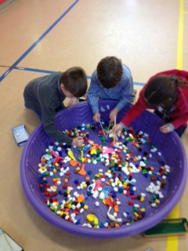
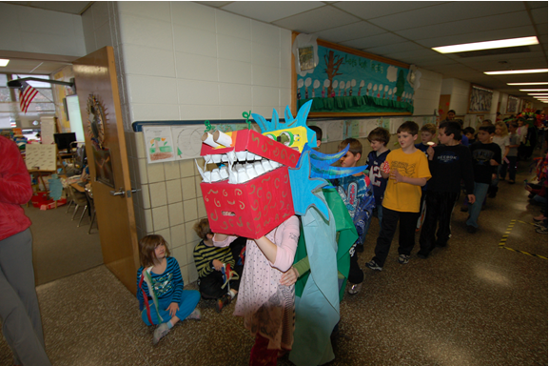
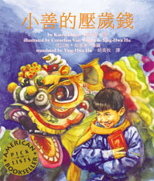
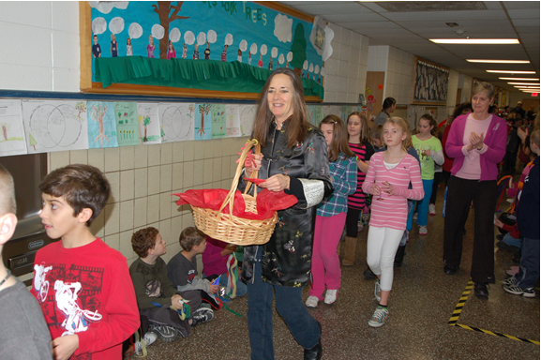
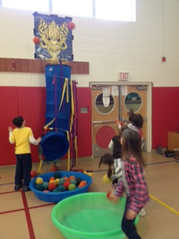
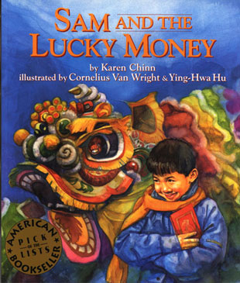
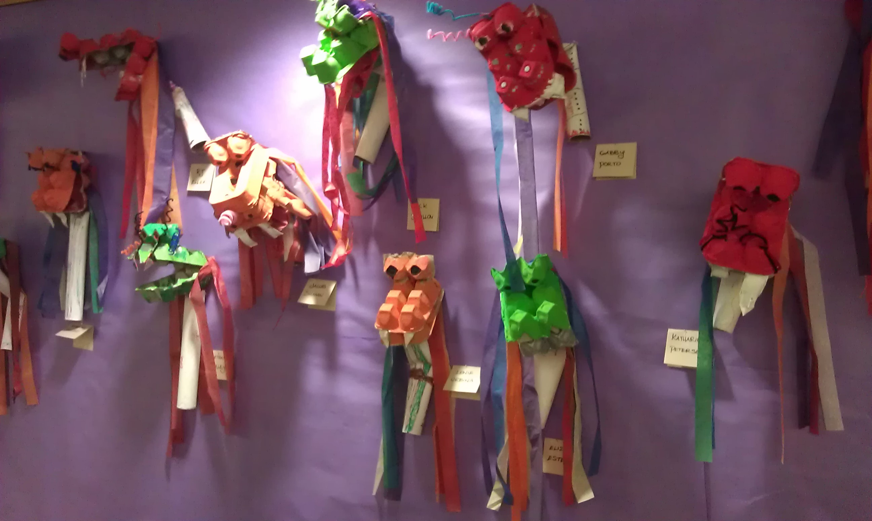
China
3
Notes:
In Library we co-read a story called “Sam and the Lucky Money” in both Chinese and in English and the students talked about what they noticed about the Chinese language version and how the character in the story was similar or different to them and learned how to write the character Fu – which means good fortune
In Music – students performed Chinese music
In Art – students created Chinese dragons for a New Year’s Parade
In Gym – students watched a Chinese dance performance

Slide 4
P.E. Music
4
“Higher order questions prompted strategic thinking and problem solving that students were able to apply to their tasks.”
Jan Huot
“Students feel confident enough to take risks and explore their own ideas when they are encouraged to think on a higher level.”
Beth Gattey
“Including more questions in our lessons created an environment or an opportunity that promoted higher order thinking.”
Maryrose Kristopik

Slide 5
Library Art
5
“The level of student engagement increased dramatically when higher order questions were incorporated into the lessons.”
Yvonne Cech
“While we were collaborating to help each other incorporate higher order questions into our lessons, we discovered a common thread in our work.”
Leslie Gunn

Slide 6
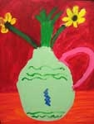
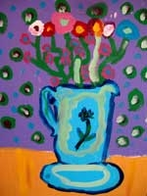
Art Students
6
“I think of my art as the space that I know in my mind.”
“I think of my art as a beautiful thing explained.”
Notes:
These were quotes from Art students after lessons using higher order questions.

Slide 7
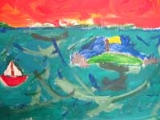
Art Students
7
“I think of my art as a dream, where the impossible becomes possible. My art for me is an enjoyable activity freeing my stressful thoughts. I learned to make my art more realistic during this painting. Art lets me be as creative and free as possible.”

Slide 8
DISCIPLINE SPECIFIC SENTENCE STARTERS
8
P.E.
Do you know of any instance in which…
How would you work together to…
Music
How would you compare…
How would you show…
Library
How would you organize these…
How would you use this information to find…
Art
How would you describe…
How would you apply what you learned to develop…

Slide 9
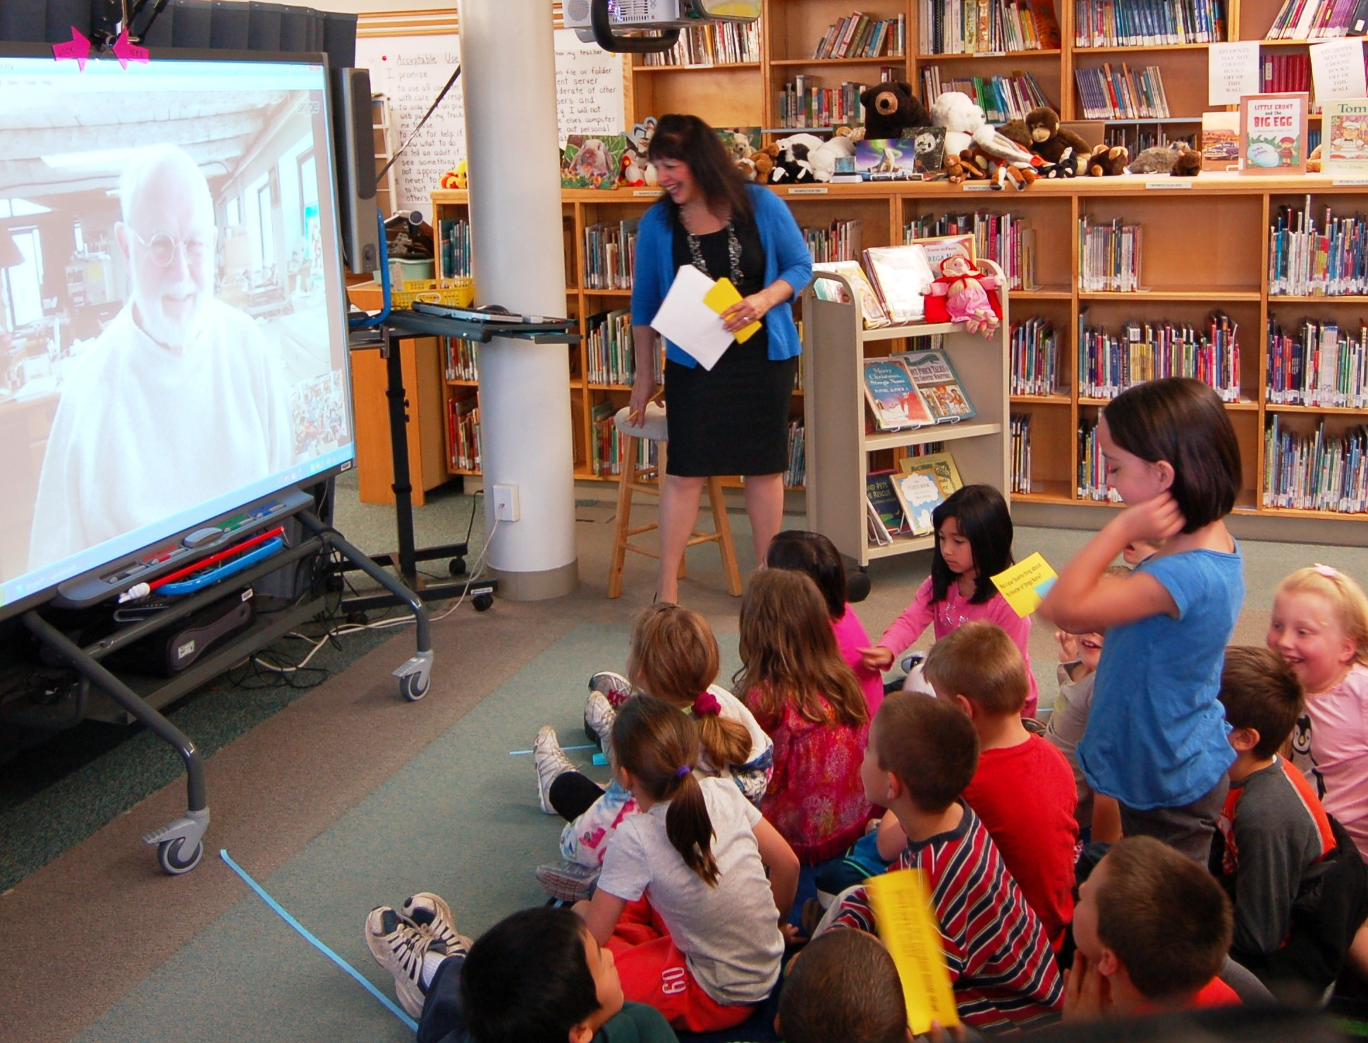
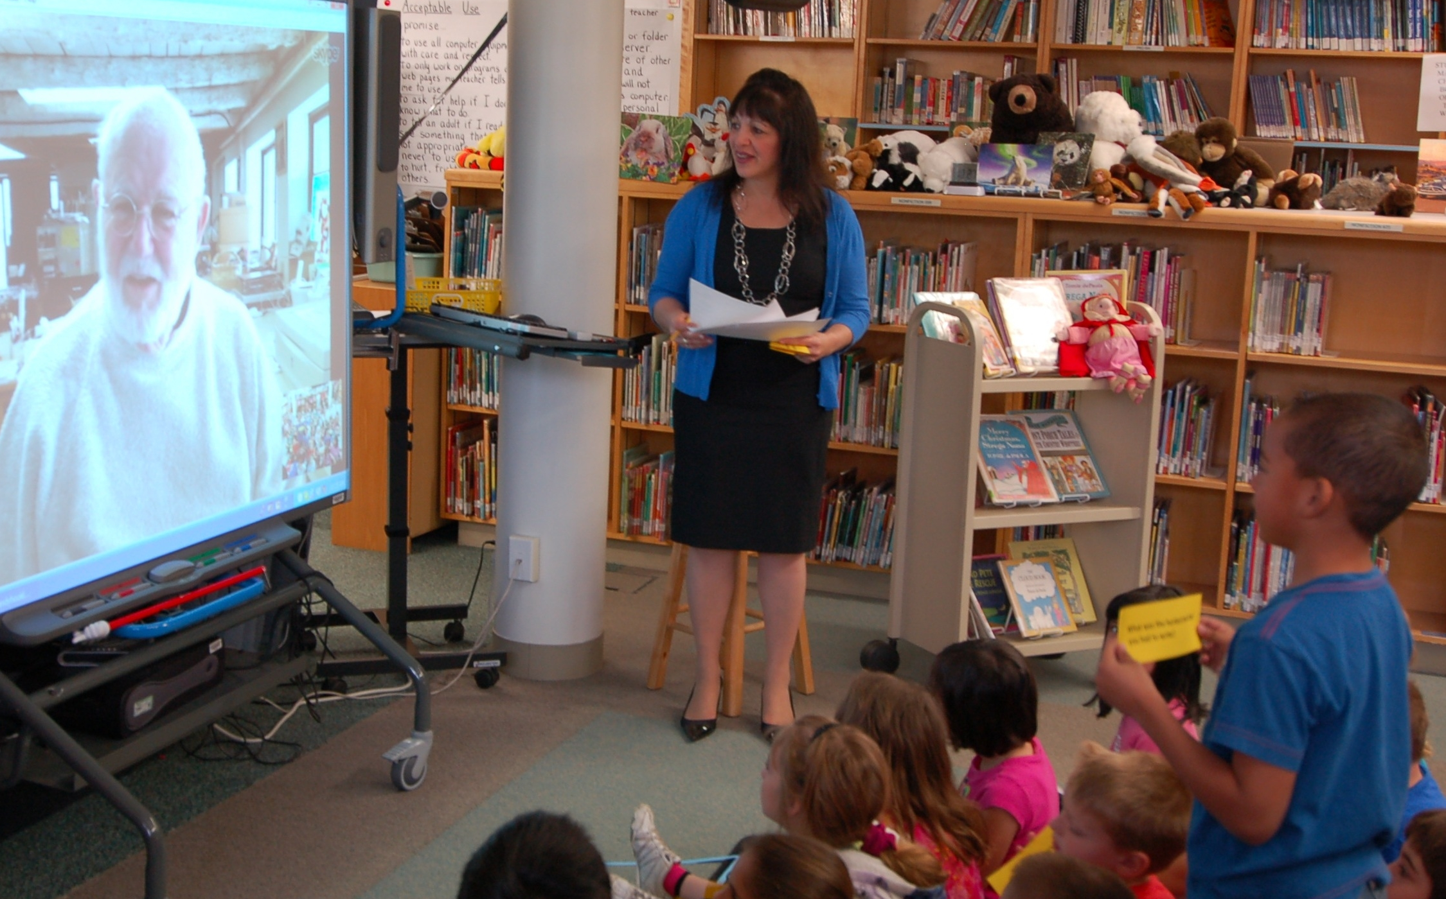
Students asked…
9
“What inspired you to be an artist, author, illustrator?”
“What do you like
most about
creating books?”

Slide 10
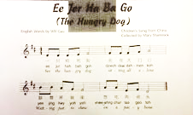
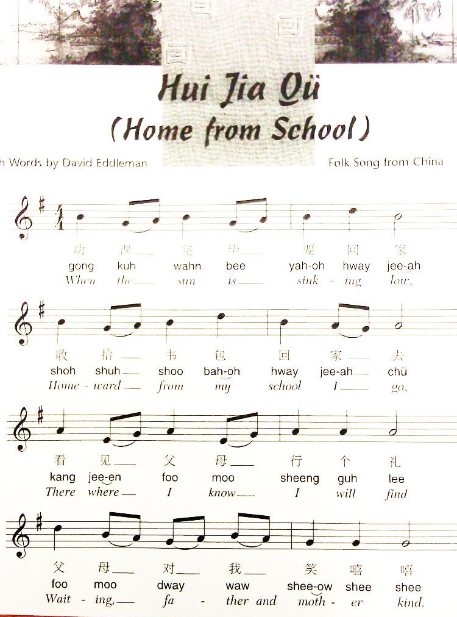
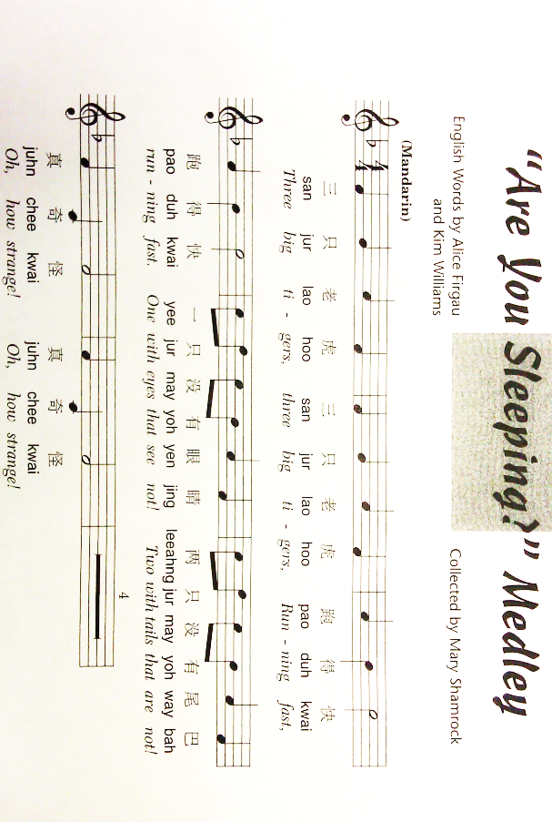
10

Slide 11
Student developed questions…
11
“What is the origin of Welsh castles?”
“What inspired you to be an artist, author, illustrator?”
“What do you like most about creating books?”

Slide 12
HOW WE CONTINUE TO BRING HIGHER ORDER QUESTIONS THROUGH OUR SUBSEQUENT WORK
12
LIBRARY
Justify why you think this is or is not a good research question.
How can we broaden this question to make it a better research question?
ART
If you could shrink yourself and go through your painting what would that be like?
Remember your maps – where do you want to lead the eye?
PE
Does a game like this help?
Why do we play games like this?
Visualize your strategies.
MUSIC
How can you practice your recorder songs without playing your instrument?
Create one strategy to practice without blowing.

Slide 13
Reflections
13
“The process we went through made Anderson’s questions discipline-specific as opposed to a vague concept.” -- Jan Huot
“It was a good process for us to take ownership of what applied to us and how we could make it work for our discipline.”
-- Maryrose Kristopik
“It made me re-think how to challenge my students to guide them toward more individual involvement and deeper understanding of the material.” -- Yvonne Cech
“This process of working together on higher order questions showed us the common thread that is woven through all of our disciplines.” -- Leslie Gunn

